Slide 1
8.
Netværksangreb mod software

Slide 2
Sikker software, hvorfor?
Usikker software
GDPR
Etik
Ansvarlighed
‘Prevention is cheaper than the cure’
NotPetya omkostninger på $1.2B
Phase | Relative cost to correct
Definition | $1
High-level Design | $2
Low-level Design | $5
Code | $10
Unit test | $15
Integration test | $22
System test | $50
Post-delivery | $100

Slide 3
Hvordan bliver software usikkert?
Design fejl
Privelegier
Insecure defaults
Defence in depth
Implementations fejl
Input validering
Fejlhåndtering
Maintainence
Patching
Udfasning
Højkvalitetssoftware = Bedre sikkerhed

Slide 4
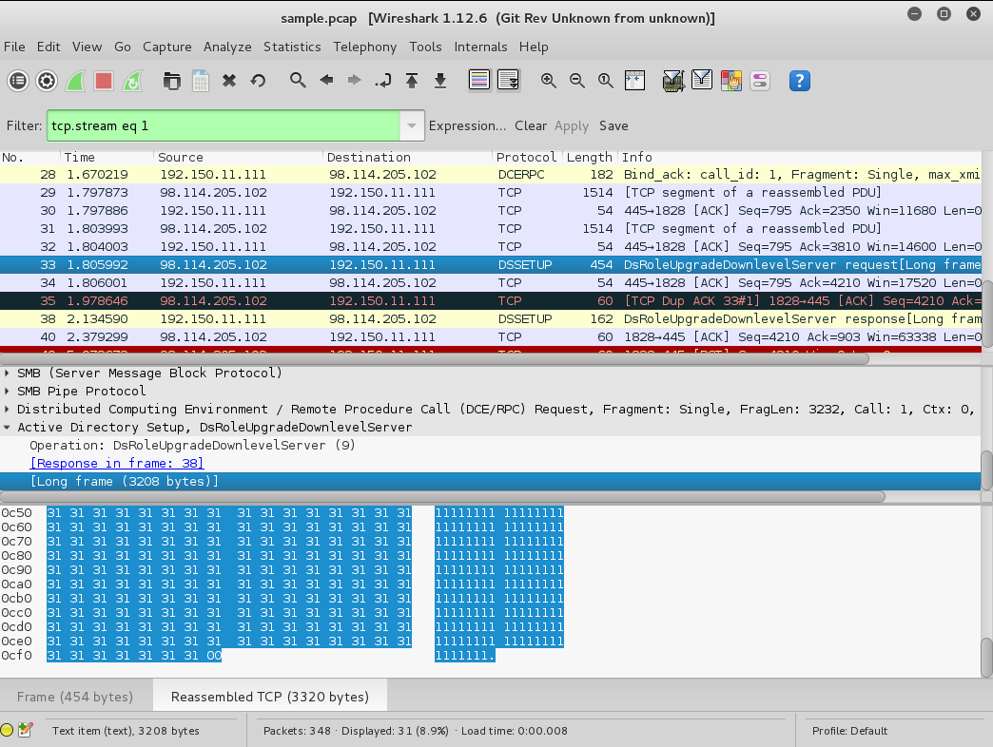
Protocol Auditing
Wireshark

Slide 5
Netværksangreb
DDOS
Common tool: LOIC
SYN flooding
CVE-2019-15846
RCE with root

Slide 6
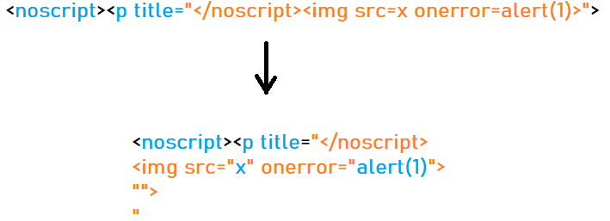
Mutation Based-XSS

